Slide 1
Nested classes

Slide 2
What is Nested Class?
Java allows you to define a class within another class. Such a class is called a nested class.
class OuterClass {
class NestedClass {
}
}
Outer classes can only be declared as public or package private. Where as, Nested class can be declared private, public, protected, or package private.

Slide 3
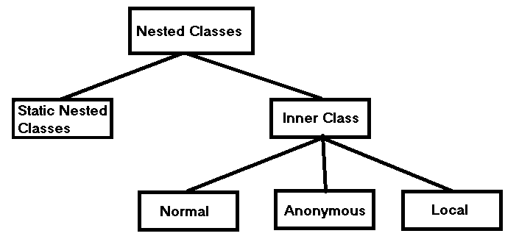
Types of Nested Classes

Slide 4
Why to use Nested classes?
Logically grouping the classes at one place.
Encapsulation advantage
More readable & maintainable code.

Slide 5
Static Nested classes
class OuterClass {
static class NestedClass {
}
}
Like static class methods, a static nested class cannot refer directly to instance variables or methods defined in its enclosing class: it can use them only through an object reference.
Static nested classes are accessed using the enclosing class name:
OuterClass.StaticNestedClass nestedObject = new OuterClass.StaticNestedClass();

Slide 6
Inner classes (Non-static nested classes)
class OuterClass {
class NestedClass {
}
}
Inner class has direct access to the outer class fields & methods. Inner class is instantiated as follows:
OuterClass.InnerClass innerObject = outerObject.new InnerClass();

Slide 7
Anonymous inner classes
Printable printableCircle = new Printable() {
public void print() {
System.out.println(“Circle printed..”);
}
};
Anonymous class makes your code brief but comprehensive.
Anonymous class enables to declare & instantiate a class at the same time.
Anonymous class is a local class with no name.
Anonymous class is used if you need local class only once.

Slide 8
Local classes
public void performArithOpr(int x, int y) {
class ArithmeticOpr { //Local class
public int add(int a, int b) {
return a + b;
}
}
}
Local class has access to the members of its enclosing class & also to local variables.
Local classes can be declared inside method, if condition, loops etc.

